Slide 1
Greek Literature in the Era of the
Atheno-Peloponnesian Wars (431–404 BCE)
Herodotus and His Colleagues
Spring Semester 2026
Prof. Dr. Ruobing Xian

Slide 2
Semester Survey
Semester Survey
The Ancient Greek World from 510 to 446 BC
The Atheno-Peloponnesian Wars (431–404 BC)
Compositional Date and Intellectual Context of Herodotus’ Histories

Slide 3
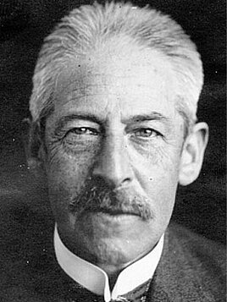
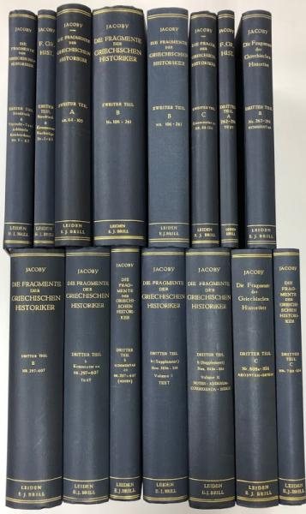
Semester Survey
Weeks 1-4
Historical and Intellectual Context of Composition
Overview of the Nine Books (oral performance alternating between the most interesting and the most tedious episodes from each book)
History of Scholarship (From Dionysius of Halicarnassus to Jacoby)
History of Scholarship (Established Approaches and New Trends)

Slide 4
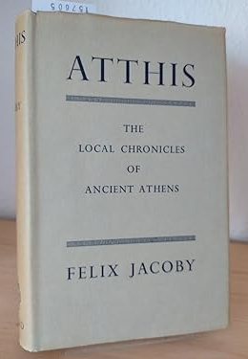

Semester Survey
Weeks 5–14
Hecataeus of Miletus (Genealogiai)
Hecataeus of Miletus (Journey Round the Earth)
Charon of Lampsakos (Persika)
Charon of Lampsakos (Hōroi ‘Yearbooks’)
Hellanikos of Lesbos (Atthis)
Hellanikos of Lesbos (Hiereiai ‘Priestesses of Hera at Argos’)
Stesimbrotus of Thasos (On Themistokles, Thucydides, and Pericles)
Ion of Chios (Epidēmiai ‘Memoirs’)
Ion of Chios (Foundation of Chios)
Weeks 15–16
Thucydides (History of the Peloponnesian War)
Course paper feedback

Slide 5
The Ancient Greek World from 510 to 446 BC
510 End of Peisistratid tyranny
499–494 Ionian Rebellion
508 Cleisthenes initiates democratic reforms
490 First Persian invasion; Battle of Marathon
487 Sortition introduced for Selection of Archons
480–479 Second Persian Invasion
483 Building of the war fleet (Themistocles)
477 Athenians form Delian League
462 reforms of Ephialtes
c. 466 Battles of the Eurymedon (Cimon)
455 Pericles’ first Generalship
461–446 First Atheno-Peloponnesian War
447 construction of Parthenon begins
446 Thirty Years’ Peace between Sparta and Athens

Slide 6
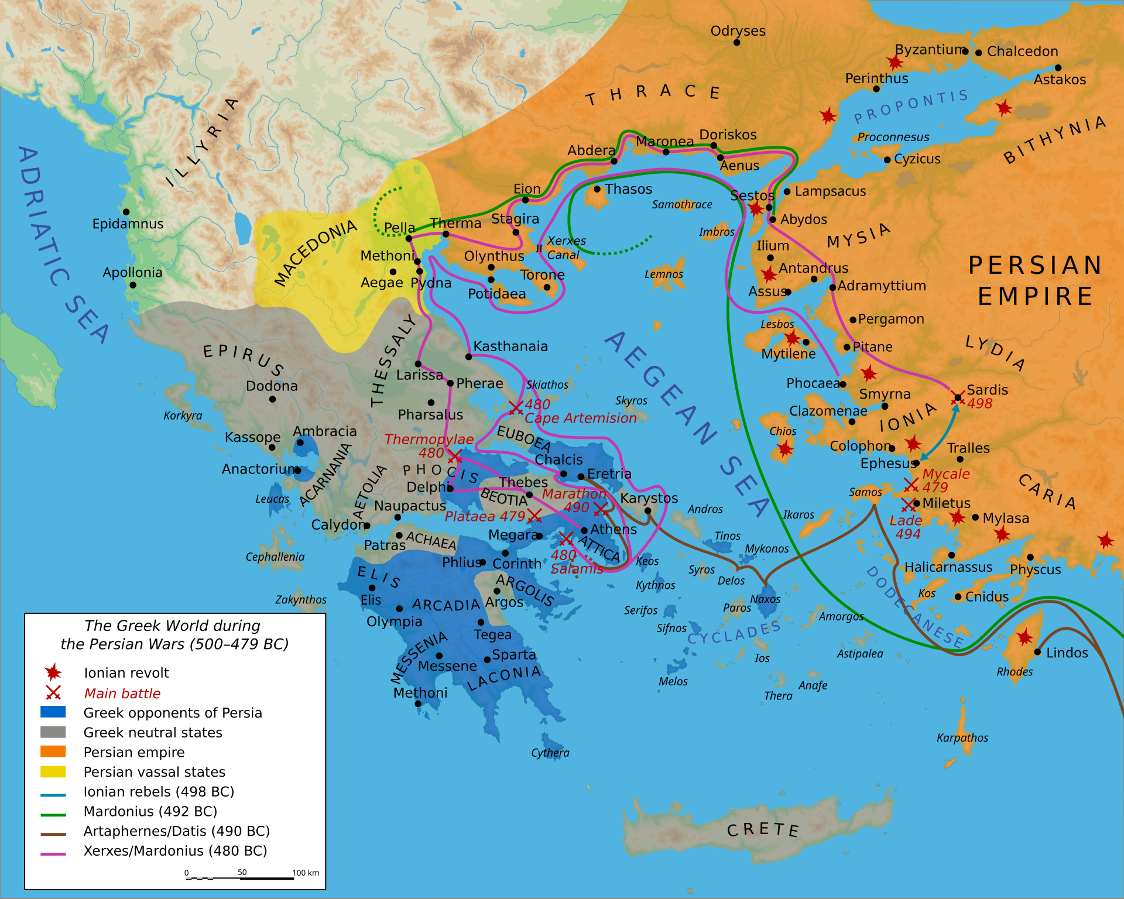
Graeco-Persian Wars

Slide 7
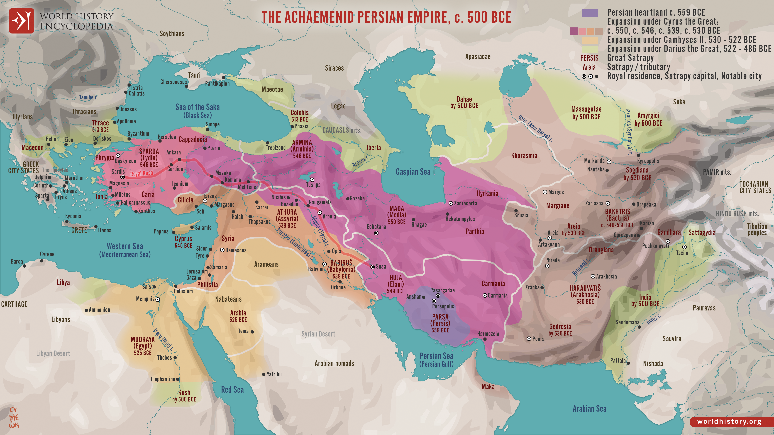
The Achaemenid Persian Empire

Slide 8
The Atheno-Peloponnesian Wars (431–404 BC)
430–427 Typhoid Fever (429, Death of Pericles)
427 Gorgias of Leontini’s Visit to Athens
421 Peace of Nicias (431–421 the Archidamian War)
423 Aristophanes’ Clouds I, City Dionysia
415–413 Athenian Expedition to Sicily
c. 420s Herodotus’ Histories
413 Spartan fortification of Decelea
411 Aristophanes’ Lysistrata
411 Regime of the Four Hundred
409 Sophocles’ Philoctetes
405 The Battle of Aegospotami
406/5 Deaths of Euripides and Sophocles
404 Siege and Surrender of Athens
405 Aristophanes’ Frogs

Slide 9
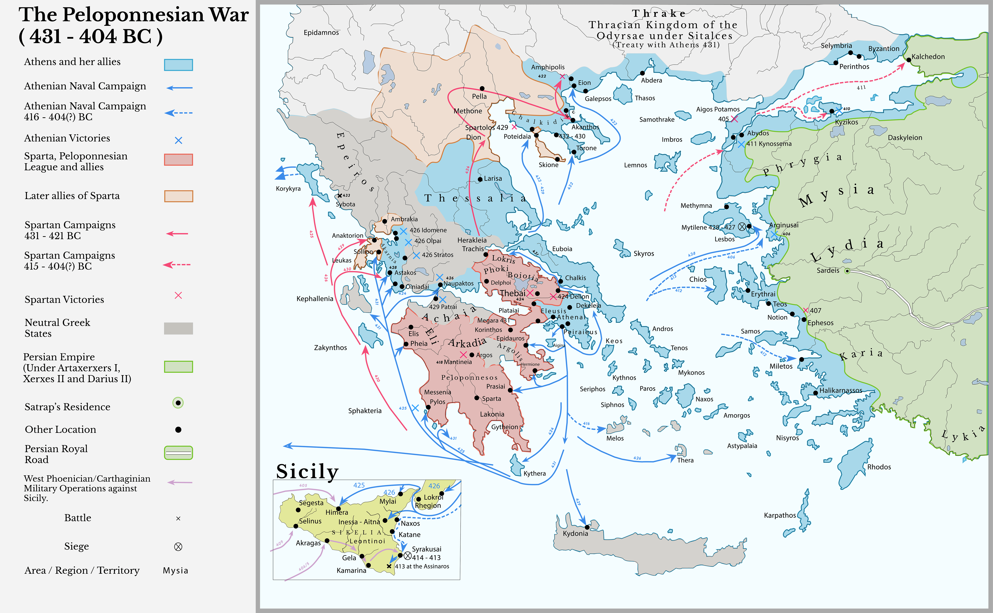
The Atheno-Peloponnesian Wars

Slide 10
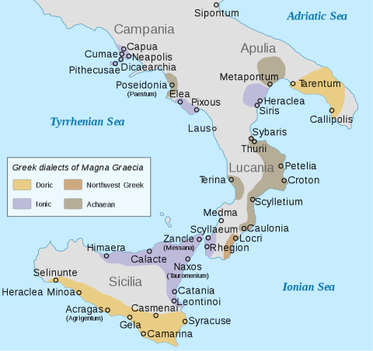
Magna Graecia

Slide 11


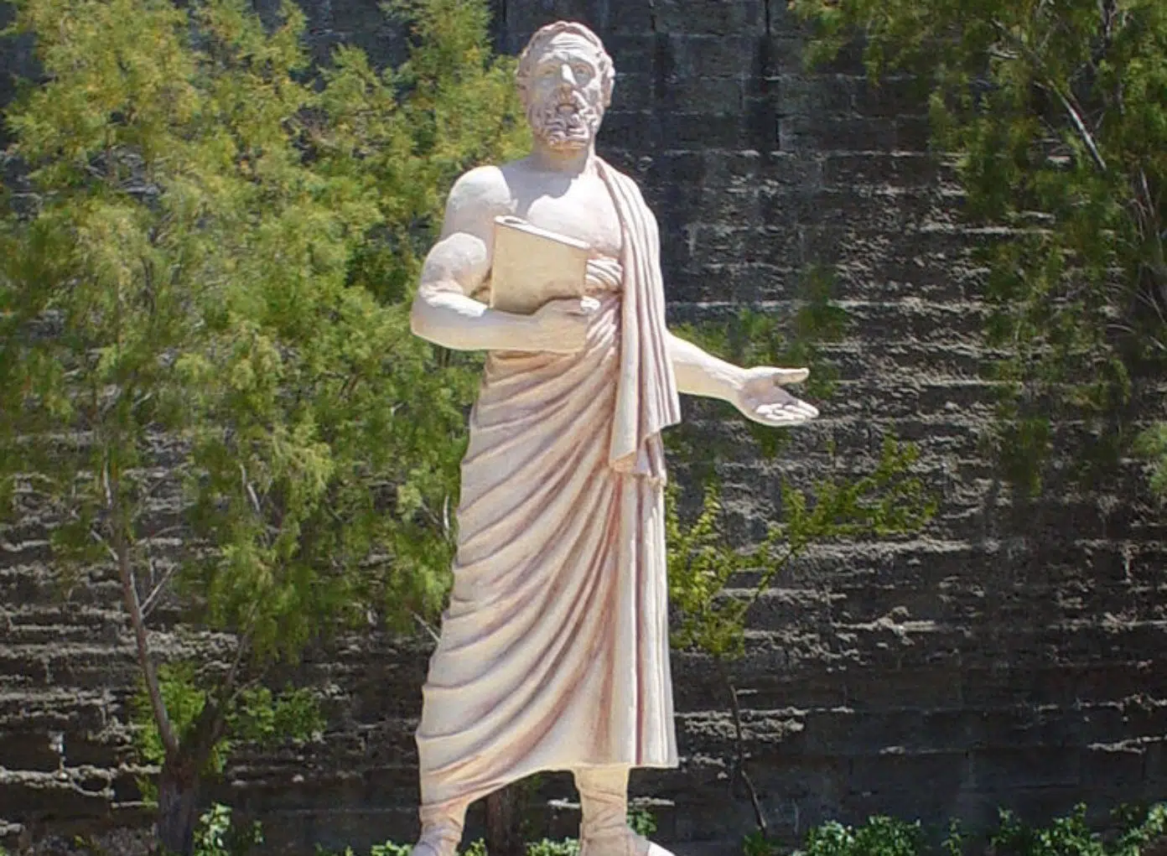
Date of Composition

Slide 12



Intellectual Context

Slide 13

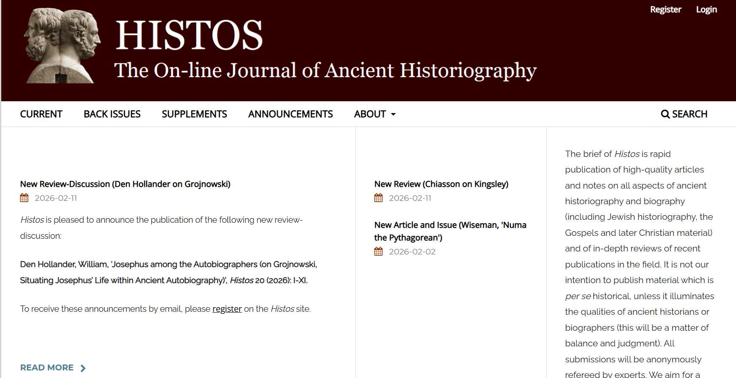
https://histos.org/index.php/histos/index
https://journals.ub.uni-heidelberg.de/index.php/syllogos/index

Slide 14
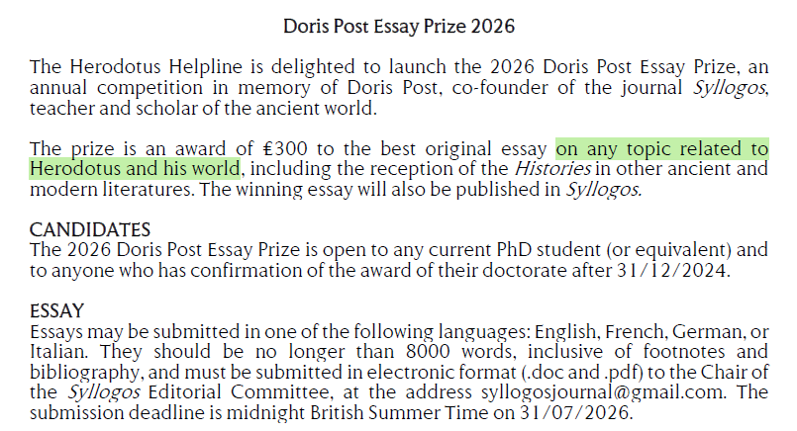
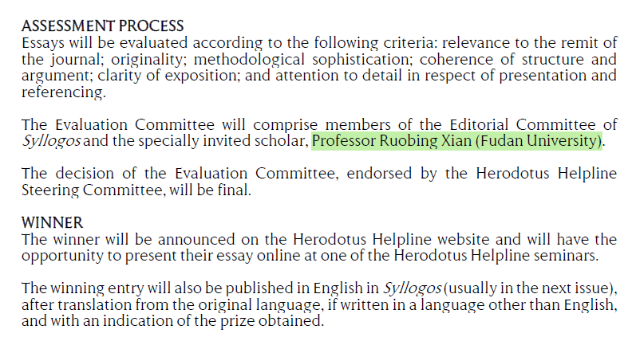

Slide 15





Thanks for your attention！
Contact: ruobingxian@fudan.edu.cn

